Slide 1


LINE FOLLOWER ROBOT
TEAM MEMBERS:
2100040069-K.DINESH REDDY
2100040079-K.MANIDEEP REDDY
2100040100-T.ANJANI KUMAR

Slide 2
contents
Introduction
Aim
Components required
Circuit diagram
Block digram
Flow of how it works
conlclusion

Slide 3
INTRODUCTION
The line follower robot is a simple robot that is based on automation that follows a specific direction based on a particular line, usually a dark line on a light surface. The robot consists of two sensors that are installed at the front end of the robot body and two wheels that are driven by DC motors. The circuit board present in the robot controls the wheel speed based on the input signal from the sensors. The controlling of the robot is done like that when the robot sees a black line it stops.

Slide 4
AIM
To built Line Following Robot which is able to follow either a black or white line that is drawn on the surface consisting of a contrasting color. It is designed to move automatically and follow the made plot line

Slide 5
COMPONENTS REQUIRED
L298N MOTOR DRIVER
2* IR SENSORS
2*BO MOTORS
F-F CONNECTING WIRES
2*WHEELS
2*BATTERIES
BATTERY CONNECTOR
SWITCH
CASTER WHEEL

Slide 6
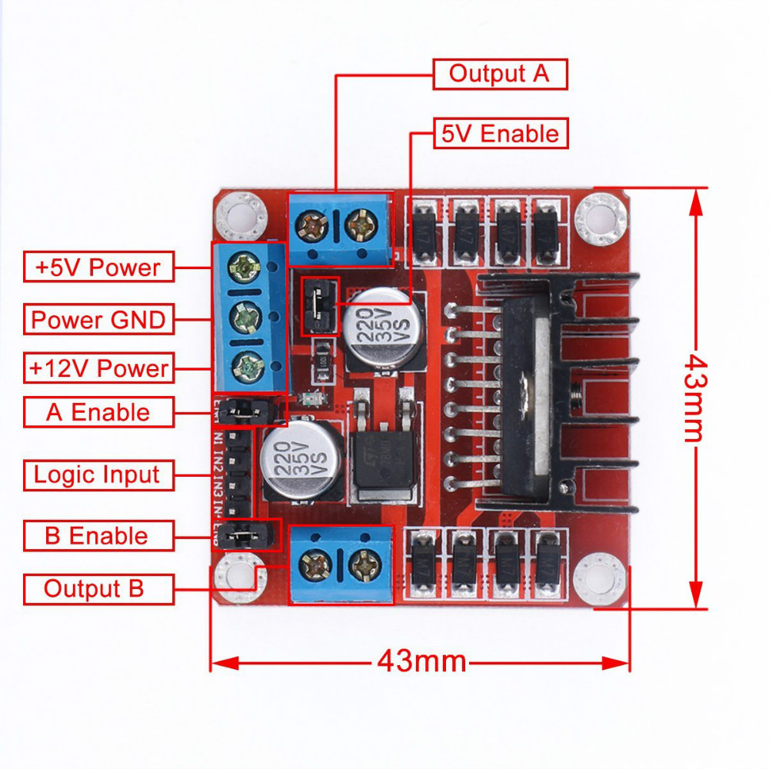
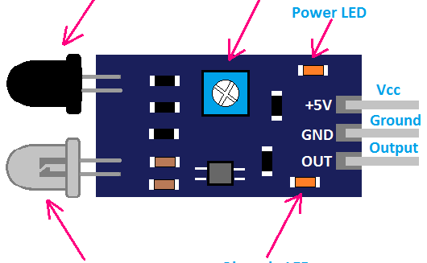
L298N MOTOR DRIVER AND IR SENSOR
An infrared (IR) sensoris an electronic device that measures and detects infrared radiation in its surrounding environment
The L298N is a dual H-Bridge motor driver which allows speed and direction control of two DC motors at the same time
This Photo by Unknown author is licensed under CC BY-SA.

Slide 7
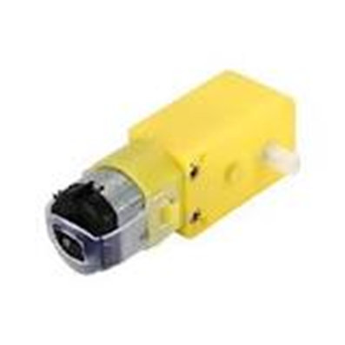
BO MOTOR
Bo motor (Battery Operated) lightweight DC geared motor which gives good torque and rpm at lower voltages. Here you can get bo motor with varying rated speed.

Slide 8
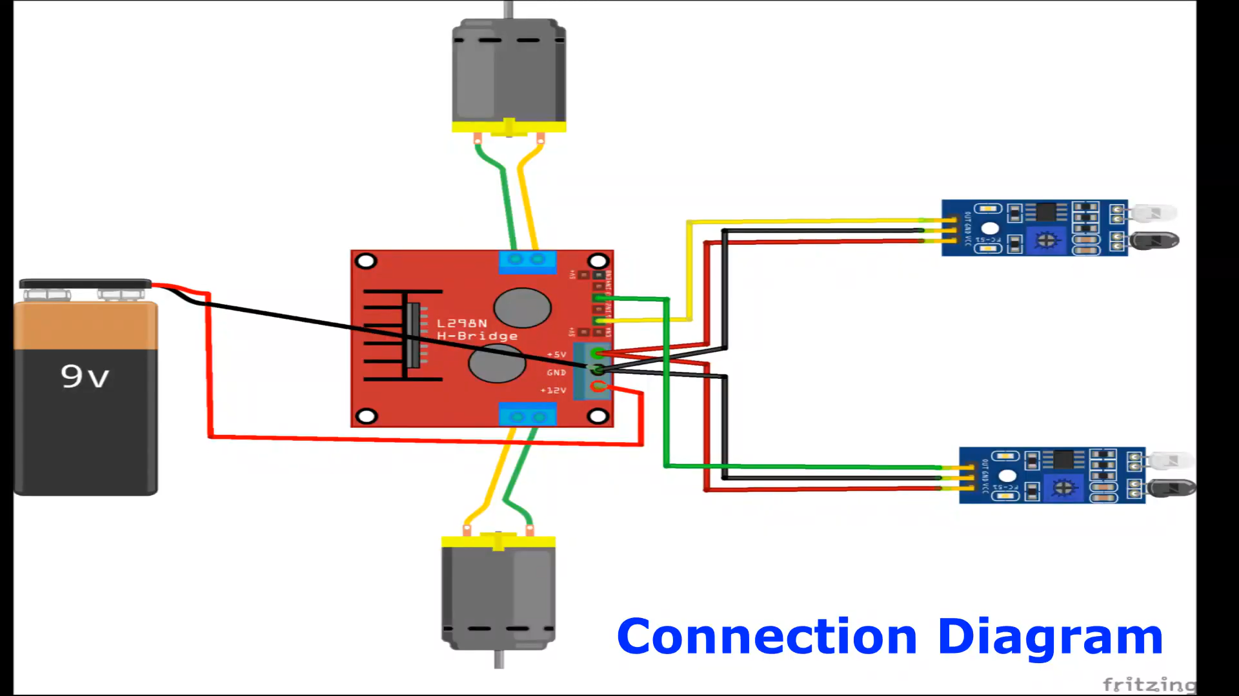
CIRCUIT DIAGRAM

Slide 9
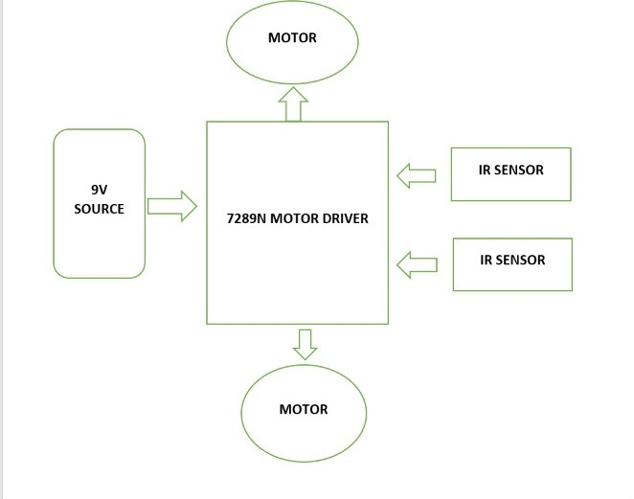
Block diagram

Slide 10
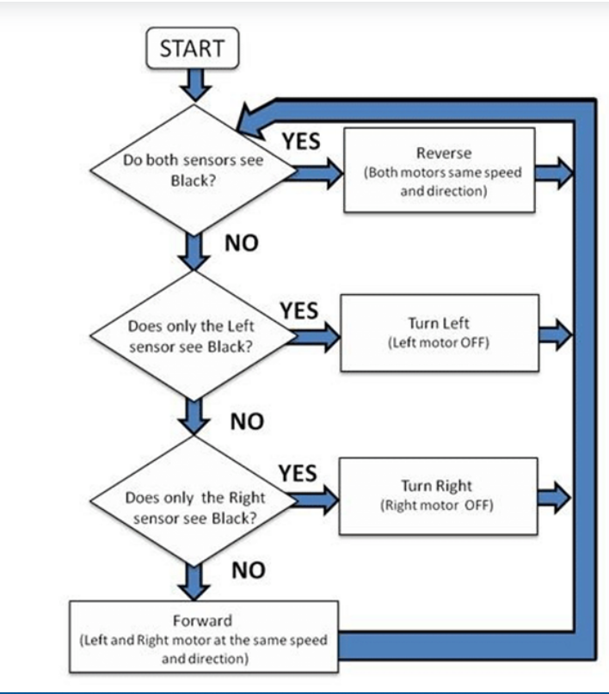
FLOW CHART HOW THE ROBOT WORKS

Slide 11
CONCLUSION
•The Line follower robot works successfully to track on the black line. Above the white surface (art paper) there are some black lines in different directions. The robot still good enough to sense the line and follows the track. Also the robot is capable to carry some load likely 500gm.

Slide 12
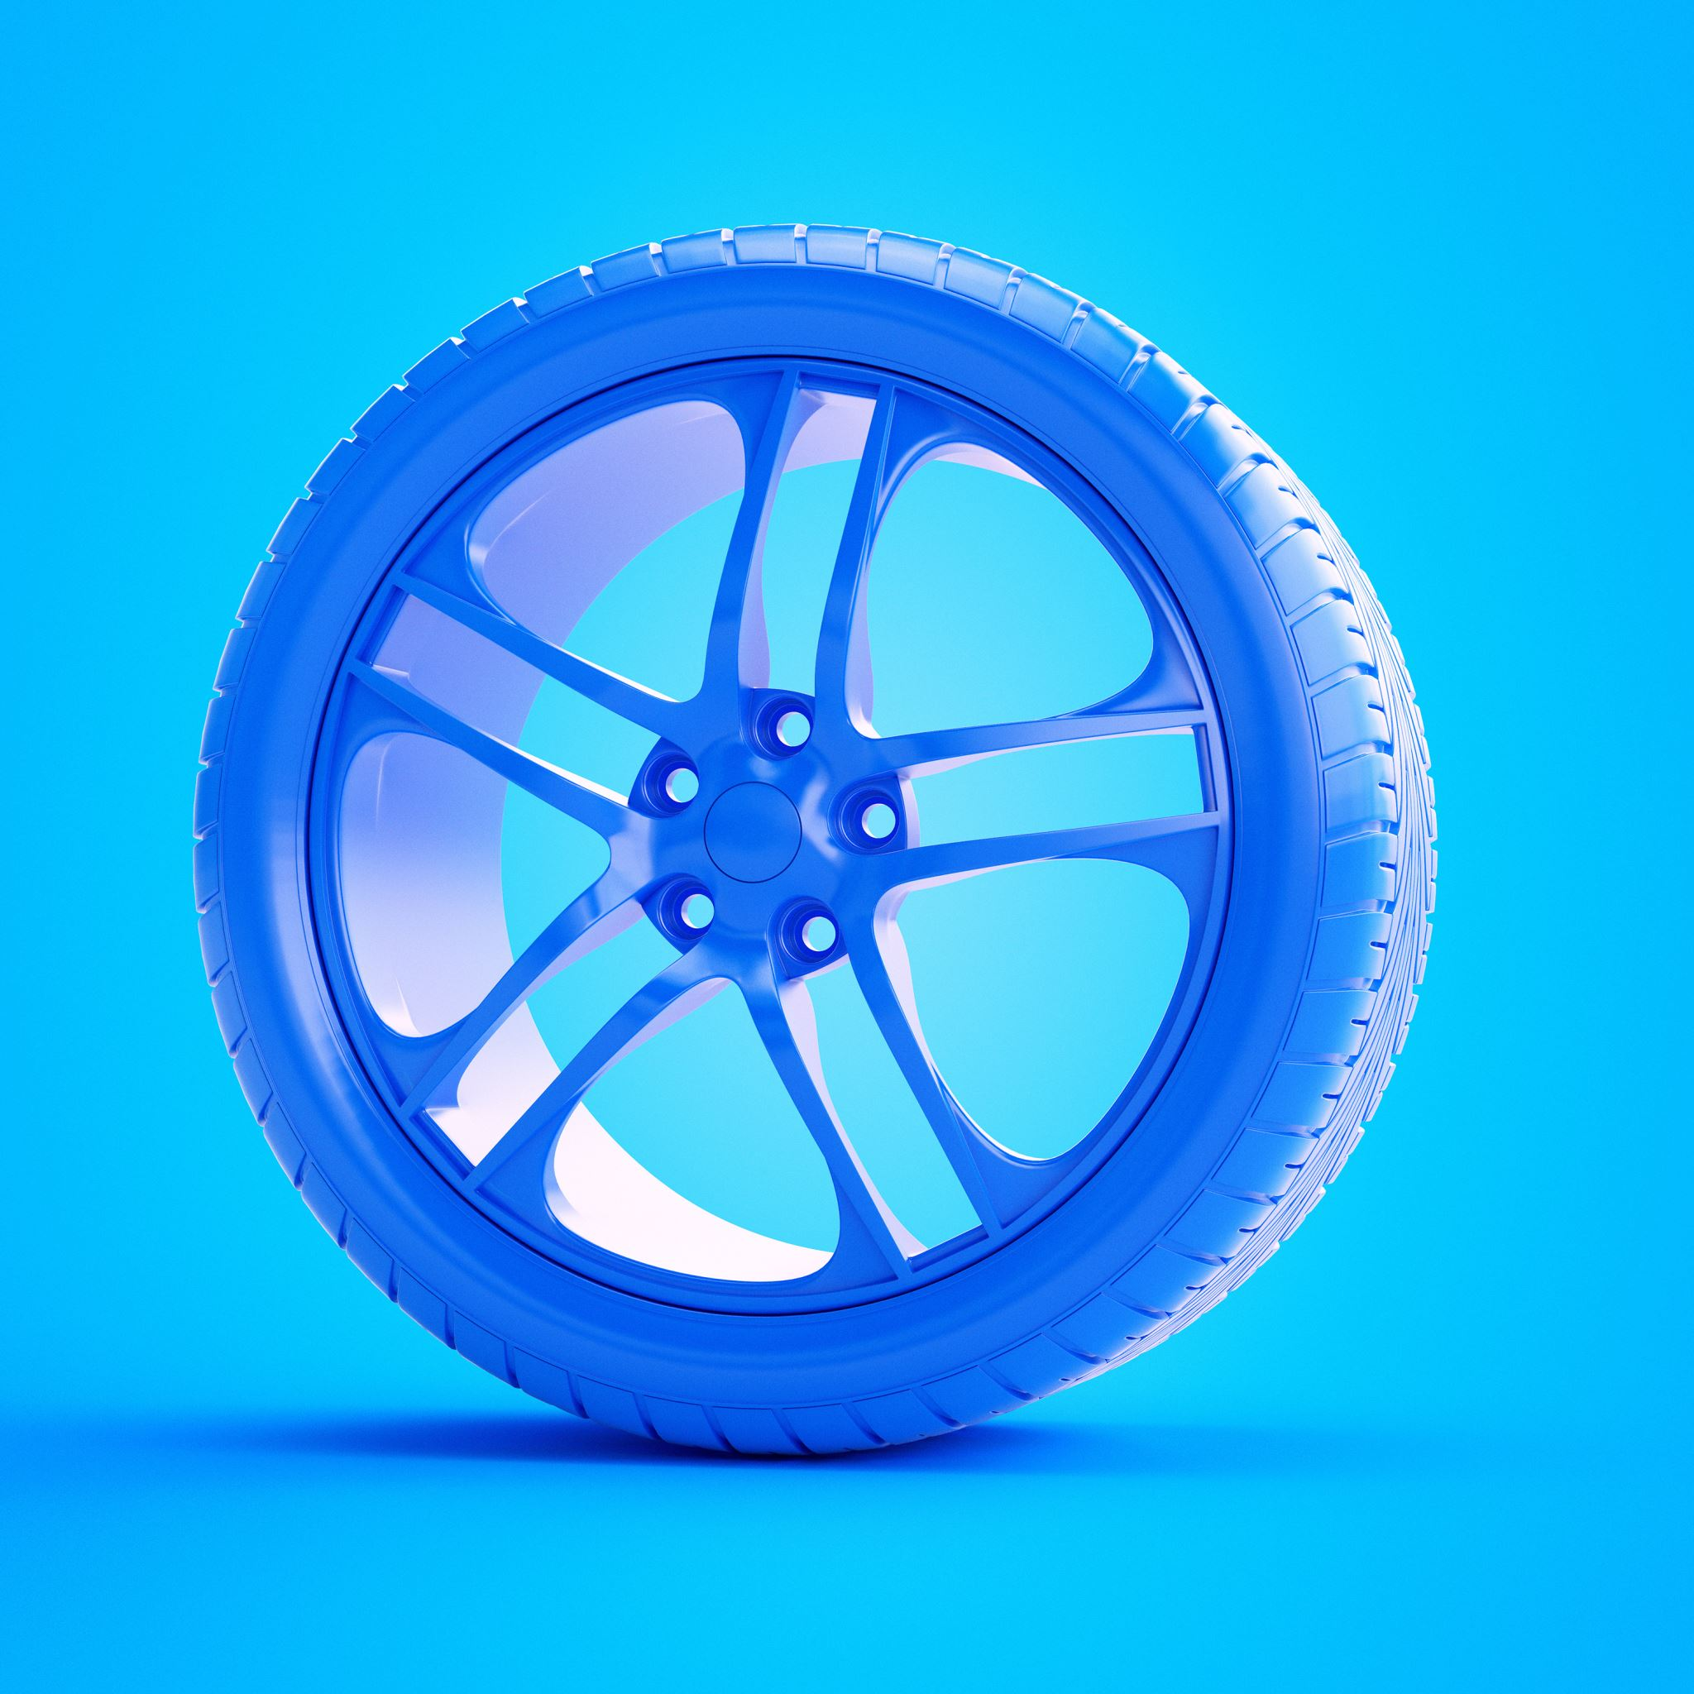
PROBLEMS THAT WE ARE FACING
The only problem that we are facing is if one wheel is moving then the other wheel is not moving and vice versa

